Slide 1
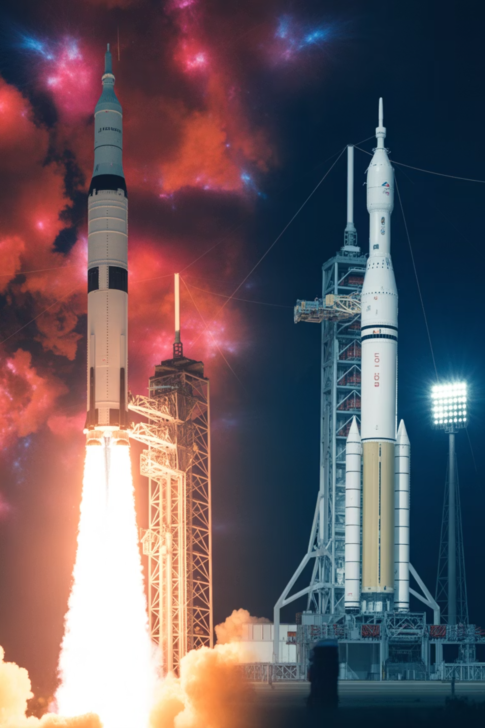
Apollo to Artemis: The Space Narrative
From the first lunar footsteps to a sustainable return—how Apollo's legacy powers Artemis and the path to Mars. More than fifty years separate humanity's initial Moon landings from our imminent return, yet the bold vision remains unchanged: to explore, to discover, and to expand our presence beyond Earth. This presentation traces the remarkable journey from Apollo's pioneering missions through the transformative Artemis program, examining how technological evolution, international collaboration, and renewed ambition are shaping our future among the stars.

Slide 2
Agenda
01
02
03
Key Figures & Quotes
Vehicle Evolution
Mission Timeline
Visionaries who shaped lunar exploration
Saturn V → SLS/Orion; Starship context
Apollo to Artemis chronology
04
05
06
Budget Trends
Technology Advances
Risks & Mitigations
Inflation-adjusted program costs
Materials, computing, guidance systems
Challenges and engineering solutions
07
08
09
International Partners
Cultural Impact
What's Next
Global collaboration framework
How space exploration transforms society
The road to sustained lunar presence

Slide 3


Key Figures & Quotes
The journey to the Moon and back again has been defined by visionary leaders, courageous explorers, and profound moments of reflection. These voices shaped not only the technical trajectory of space exploration but also how humanity perceives its place in the cosmos.
John F. Kennedy
Neil Armstrong
Set the Moon landing goal in his historic 1961 Rice University speech, catalyzing Apollo funding, schedule, and national focus during the height of the Cold War.
Commander of Apollo 11 and the first human to set foot on the Moon. A test pilot with exceptional skill, Armstrong flew missions during Gemini and Apollo programs.
We choose to go to the Moon in this decade and do the other things, not because they are easy, but because they are hard.
That's one small step for [a] man, one giant leap for mankind.
Bill Anders
Gene Cernan
Apollo 8 astronaut who captured the iconic Earthrise photograph, fundamentally shifting public perspective toward viewing Earth as a fragile, unified world.
Apollo 17 commander and the last human to walk on the Moon in 1972. His geology-focused exploration with Harrison Schmitt expanded scientific understanding of lunar formation.
We came all this way to explore the Moon, and the most important thing is that we discovered the Earth.
We leave as we came, and, God willing, as we shall return, with peace and hope for all mankind.

Slide 4
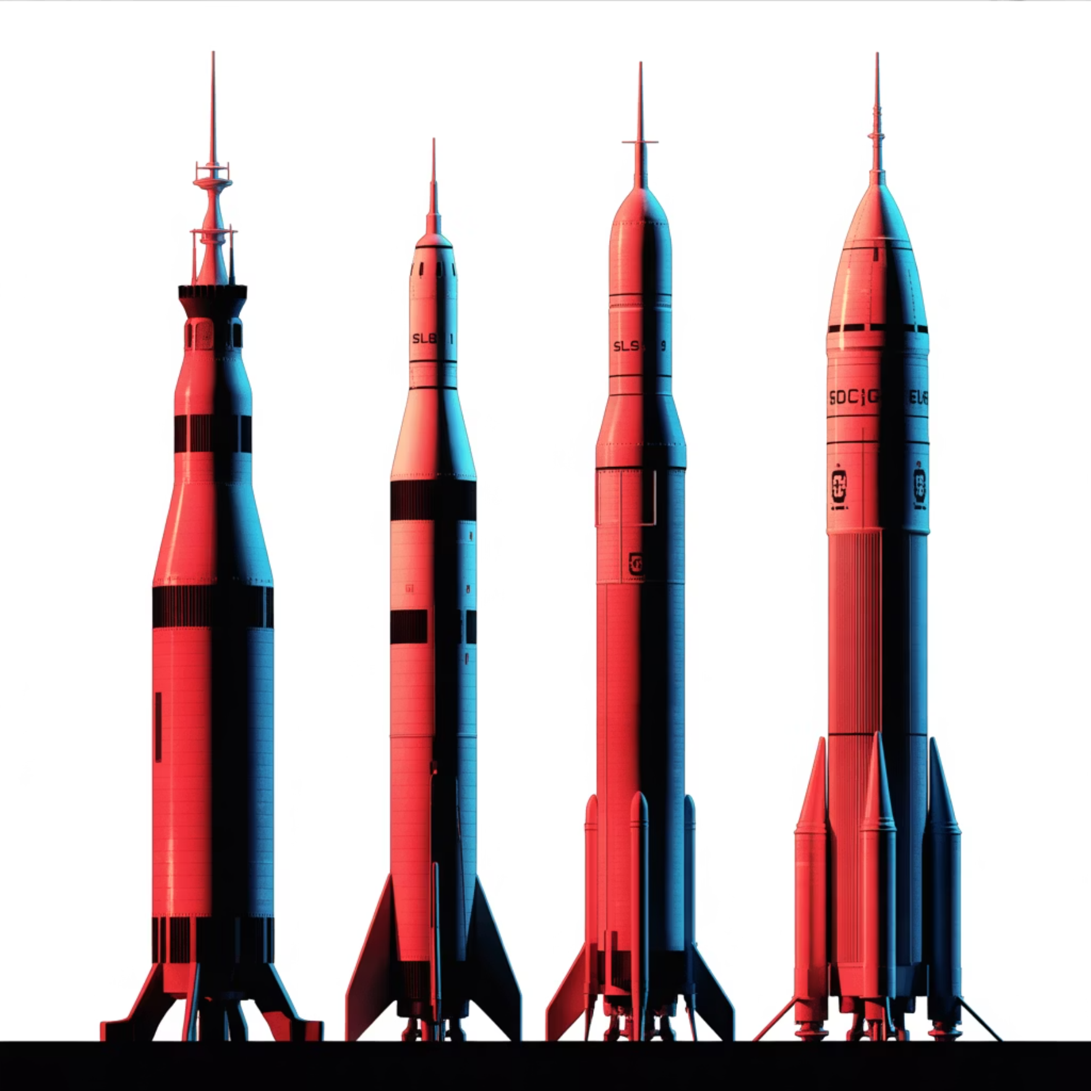
Vehicle Evolution: Saturn V → SLS/Orion
The engineering marvels that carry humans to deep space have evolved dramatically over six decades. From the mighty Saturn V that enabled the Apollo missions to the modern Space Launch System designed for sustainable exploration, each generation builds upon hard-won lessons while incorporating transformative technologies. The table below compares payload capacities to Low Earth Orbit (LEO) and Trans-Lunar Injection (TLI), illustrating how mission architecture has adapted to new objectives and capabilities.
System
LEO (tons)
TLI (tons)
Notes
Saturn V + Apollo CSM/LM (1967–1973)
~140
~48
Expendable; three-stage kerolox/hypergolic; Moon landings via LM
SLS Block 1 + Orion (Artemis I–III)
~95
~27
Expendable; RS-25 + 5-segment SRBs; Orion for deep-space crew
SLS Block 1B + Orion (Artemis IV+)
~105
~38–42
EUS upper stage; Gateway and larger payloads
Starship HLS (Artemis III+)
100–150
≥100
Fully reusable; lunar lander under NASA contract; on-orbit refueling
Key Insight: Orion's crew module and service module represent significant advances in life support, radiation protection, and abort capability compared to Apollo's Command and Service Module, despite lower raw payload numbers.
TLI lift varies by trajectory and margins; values are approximate and subject to mission-specific requirements.

Slide 5
Mission Timeline: Apollo to Artemis
The path from Apollo's pioneering achievements to Artemis's sustainable exploration spans more than six decades of planning, innovation, and renewed commitment. This timeline captures the defining moments that marked humanity's first steps on another world and charts our course back to the lunar surface with broader international participation and advanced technology.
1961
1
JFK sets Moon goal within the decade, launching the Apollo program
2
1968
Apollo 8: first crewed lunar orbit; Earthrise photograph captured
1969
3
Apollo 11: first lunar landing
4
1970
Apollo 13: safe return after in-flight anomaly
1972
5
Apollo 17: last crewed Moon landing of Apollo era
6
2011
SLS authorized; Orion deep-space capsule baseline established
2014
7
Orion EFT-1 uncrewed test in Earth orbit
8
2020
Artemis Accords framework announced
2022
9
Artemis I: uncrewed SLS/Orion lunar mission
10
2025
Artemis II: crewed lunar flyby (NET)
2026
11
Artemis III: crewed lunar landing (NET)
12
2028
Artemis IV: Gateway assembly; SLS Block 1B (NET)
NET = No Earlier Than; schedules subject to change based on testing outcomes and readiness reviews.

Slide 6
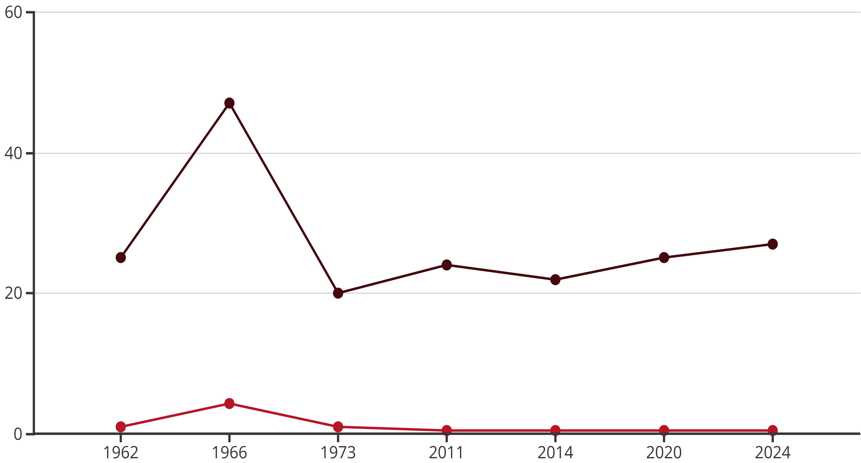
Budget Trends: Investing in Exploration
Understanding the financial commitment to space exploration reveals much about national priorities and the scale of ambition across generations. At its peak in 1966, NASA commanded approximately 4.3% of the entire U.S. federal budget—a staggering investment that reflected Cold War urgency and the Apollo program's national priority. Today's Artemis program operates in a dramatically different fiscal environment, with NASA receiving roughly 0.4–0.5% of federal outlays. While absolute spending in inflation-adjusted dollars remains substantial, modern budgets must balance crewed exploration with robotic science missions, Earth observation, aeronautics research, and International Space Station operations.
NASA Budget (Constant 2023 $B)
Share of Federal Budget (%)
The chart illustrates two critical eras: the Apollo program's dramatic rise and fall (1962–1973, shaded in soft gold) and the gradual buildup of Artemis capabilities (2011–2024, shaded in soft blue). Modern costs reflect enhanced safety standards, sustainability objectives, and the complexity of maintaining diverse mission portfolios. Artemis also benefits from international cost-sharing and commercial partnerships that help extend budgetary reach.
Values are indicative and rounded; constant-dollar conversions depend on inflation index methodology and may vary across sources.

Slide 7







Technology Advances: Six Decades of Innovation
The technological chasm between Apollo and Artemis spans revolutionary advances across every engineering discipline. Where Apollo astronauts relied on slide rules, paper charts, and analog guidance computers with mere kilobytes of memory, Artemis crews benefit from model-based software, digital twins, and processors millions of times more powerful. Materials science has progressed from basic aluminum alloys to advanced aluminum-lithium composites and additively manufactured engine components that reduce mass while improving performance. Guidance systems have evolved from mechanical inertial platforms to strapdown IMUs integrated with star trackers and, near Earth, GNSS assistance for unprecedented navigational precision.
Advanced Materials
Computing Power
Al-Li alloys, composites, additive-manufactured engine parts; refined thermal protection systems validated through arc-jet testing
From Apollo's kilobyte-scale AGC to modern rad-hard processors with orders-of-magnitude more capability and fault tolerance
Digital Engineering
Guidance & Navigation
Digital twins, hardware-in-the-loop testbeds enabling comprehensive verification before flight
Strapdown IMUs, star trackers, Terrain Relative Navigation, hazard detection LIDAR for precision powered descent
Deep-Space Comms
Life Support Systems
Optical and laser communications offering higher bandwidth for data-rich science and real-time operations
Closed-loop ECLSS improvements enabling longer missions with better reliability and resource conservation
These advances collectively enable Artemis missions to be safer, more capable, and scientifically productive than Apollo, while supporting sustainable exploration architectures that previous generations could only imagine.

Slide 8
Risks and Mitigations
Every ambitious space program confronts technical uncertainties, operational hazards, and programmatic challenges. Artemis inherits Apollo's pioneering spirit while incorporating decades of systems engineering maturity and risk management discipline. The program's success depends on methodically addressing each challenge through rigorous testing, redundant systems, operational constraints, and strategic planning. Below are the primary risk areas and the comprehensive mitigation strategies being implemented to ensure crew safety and mission success.
Heat Shield Performance
Deep-Space Radiation
Risk: Charring behavior in high-energy lunar return reentry remains incompletely characterized.
Risk: Exposure to solar particle events (SPEs) and galactic cosmic rays (GCRs) poses health hazards during extended cislunar missions.
Mitigation: Design refinements informed by arc-jet testing, flight-like test coupons, and instrumented reentry data from Artemis I; closeout reviews before crewed flight.
Mitigation: Storm shelters within Orion and Gateway, passive shielding materials, mission timing to avoid solar maximum, real-time dosimetry and operational constraints.
Lunar Landing Precision
Cryogenic Propellant Transfer
Risk: Hazardous terrain at polar landing sites could jeopardize vehicle stability and crew safety.
Risk: On-orbit transfer for Starship HLS refueling is operationally unproven at scale.
Mitigation: Incremental ground and orbital demonstrations, boil-off control systems, multi-tanker architecture with correlated test data.
Mitigation: Terrain Relative Navigation (TRN), autonomous hazard detection systems, extensive rehearsals with uncrewed demos and high-fidelity simulations.
Integration Complexity
Budget and Policy Volatility
Risk: Coordinating multiple providers (NASA, ESA, commercial) across interfaces and schedules.
Risk: Funding gaps or shifting political priorities could delay or cancel program elements.
Mitigation: Rigorous interface control documents, phased verification campaigns, margin reserves, independent readiness reviews.
Mitigation: Modular milestone structure, international cost-sharing agreements, multi-year procurement contracts, bipartisan stakeholder engagement.

Slide 9
International Partners: A Global Endeavor
Artemis represents humanity's most collaborative space exploration effort to date, uniting agencies and nations in pursuit of shared goals on and around the Moon. Unlike Apollo's largely unilateral American achievement, Artemis distributes technical contributions, costs, and benefits across a growing coalition. The European Space Agency provides critical Orion service modules, Japan contributes advanced life support and logistics capabilities, Canada supplies next-generation robotics, and commercial U.S. providers deliver landers and surface systems. The Artemis Accords—signed by over 30 nations—establish transparent norms for interoperability, resource utilization, and safe operations, creating a foundation for sustained international cooperation.
ESA (Europe)
JAXA (Japan)
Orion European Service Module
Gateway life support and logistics
Gateway modules (I-HAB, ESPRIT)
HTV-X cargo vehicle derivatives
Science payloads and experiments
Lunar surface systems studies
CSA (Canada)
Commercial (U.S.)
Canadarm3 for Gateway robotics
HLS providers (Starship, Blue Moon)
AI-enabled autonomous operations
CLPS lunar payload deliveries
Crew support systems
Comms, navigation, habitats
This distributed architecture not only shares financial and technical burdens but also ensures that Artemis benefits from diverse engineering perspectives, fosters diplomatic ties, and builds a resilient coalition capable of sustaining exploration through political and economic cycles. The Artemis Accords signatories represent a broad commitment to peaceful, transparent, and mutually beneficial lunar activities.

Slide 10
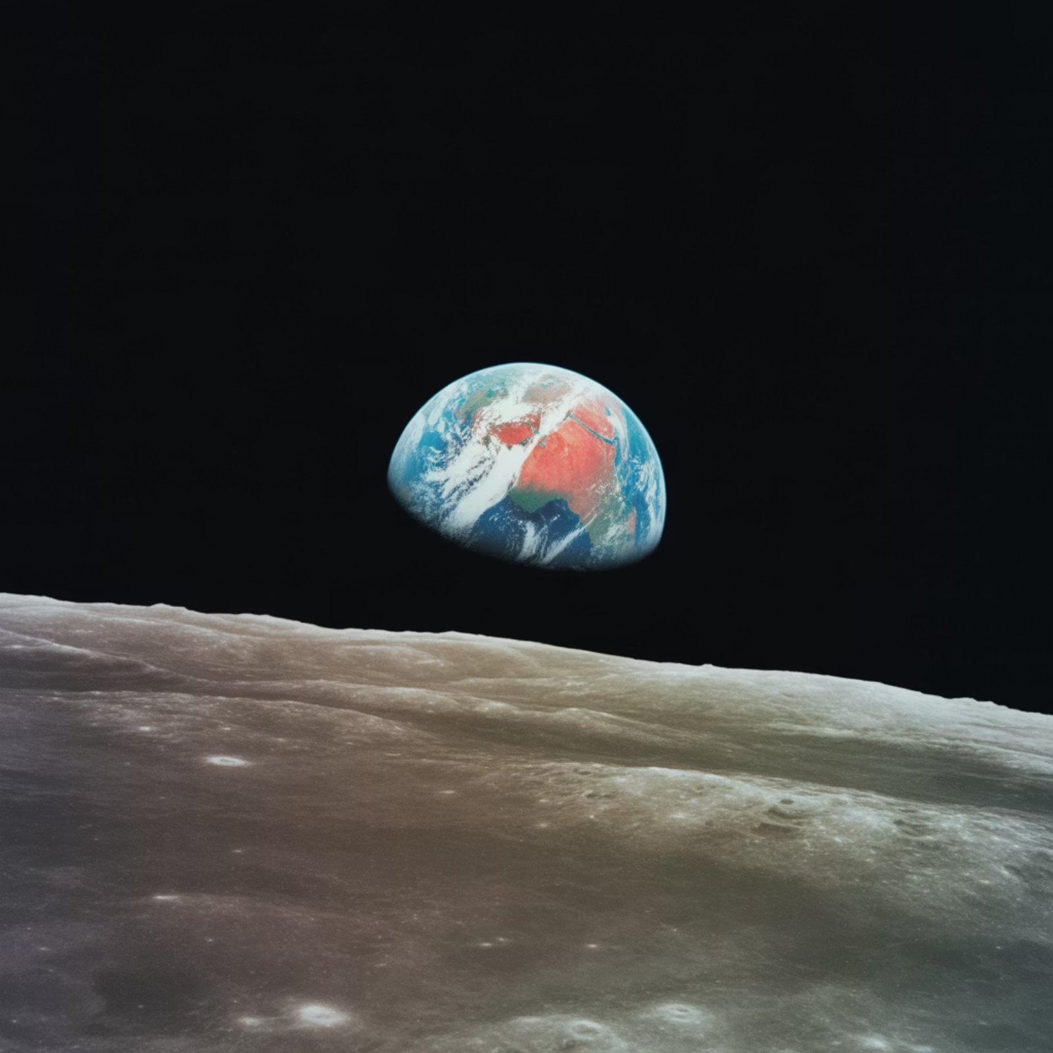
Cultural Impact: How Space Exploration Shapes Us
A Mirror to Humanity
Apollo's greatest legacy may not be technological but philosophical. The Earthrise photograph captured during Apollo 8 and the Blue Marble image from Apollo 17 fundamentally reshaped global environmental awareness, revealing our planet as a fragile oasis suspended in the cosmic void. These images catalyzed the modern environmental movement and inspired a generation to think beyond national borders.
STEM Inspiration
Shared Global Moments
Apollo ignited the imaginations of millions, driving generations of students into science, engineering, and mathematics careers. The ripple effects continue today as Artemis showcases cutting-edge technology and diverse role models.
Live lunar landing broadcasts united humanity in collective awe. Classrooms worldwide paused; public squares filled with crowds watching grainy transmissions. These shared experiences transcended politics and culture.
Expanding Representation
Commercial Era Storytelling
Artemis explicitly commits to landing the first woman and first person of color on the Moon, signaling that space exploration belongs to all humanity—not just a privileged few.
The rise of commercial spaceflight creates new icons, broader public access, and diverse narratives. Democratized participation inspires fresh creativity in art, film, and literature.
Space exploration reminds us that humanity is capable of extraordinary achievements when united by bold vision. As Artemis unfolds, it continues this cultural tradition—proving that exploration is not merely about reaching destinations but about discovering who we are and what we can become together.

Slide 11


What's Next: The Road Ahead
Artemis is not an endpoint but the beginning of a sustained human presence beyond Earth. The next decade will witness an unprecedented acceleration in lunar capabilities, international collaboration, and technological maturation—all serving as a proving ground for the ultimate goal of sending humans to Mars. The roadmap below outlines near-term missions, mid-term infrastructure development, and longer-term ambitions that will transform the Moon into a hub for science, commerce, and deep-space preparation.
Longer-Term (7+ Years)
Mid-Term (3–7 Years)
Sustained lunar presence: multiple landings per year, expanded science campaigns, permanent infrastructure
Near-Term (0–3 Years)
Gateway assembly (power/propulsion, habitation, logistics modules) enabling extended crew stays
Artemis II crewed lunar flyby (NET 2025) validates life support, communications, and high-energy reentry
Mars pathfinding: closed-loop ECLSS, radiation countermeasures, advanced propulsion operations tested at scale
SLS Block 1B and Orion upgrades deliver greater payload capacity to deep space
Artemis III lunar landing (NET 2026) using HLS; science operations at south polar region
Surface systems: pressurized rovers, solar/nuclear power, initial in-situ resource utilization (ISRU) experiments
Cislunar economy: international and commercial growth in resource extraction, manufacturing, and transportation
CLPS missions delivering instruments, technology demonstrations, and resource prospecting payloads
This roadmap is ambitious yet achievable, built on the foundation of lessons learned from Apollo and the International Space Station. Success depends on sustained political will, continued international partnership, and the courage to embrace both risk and innovation. As Gene Cernan promised in 1972, we are returning—and this time, we're staying.
All schedules and mission content are subject to change based on testing outcomes, policy decisions, and partner readiness. NET = No Earlier Than.

